Slide 1
Parameters for prediction
24.11.2022

Slide 2

Lateral thinking
I cannot access this article though..

Slide 3
Content
Present the lines I’m thinking along to be on the same page
Put those thoughts into perspective
Explain multi-task model architecture
Geological evaluation/intuition/experience
Discussion on design parameters
Classification Network technique

Slide 4

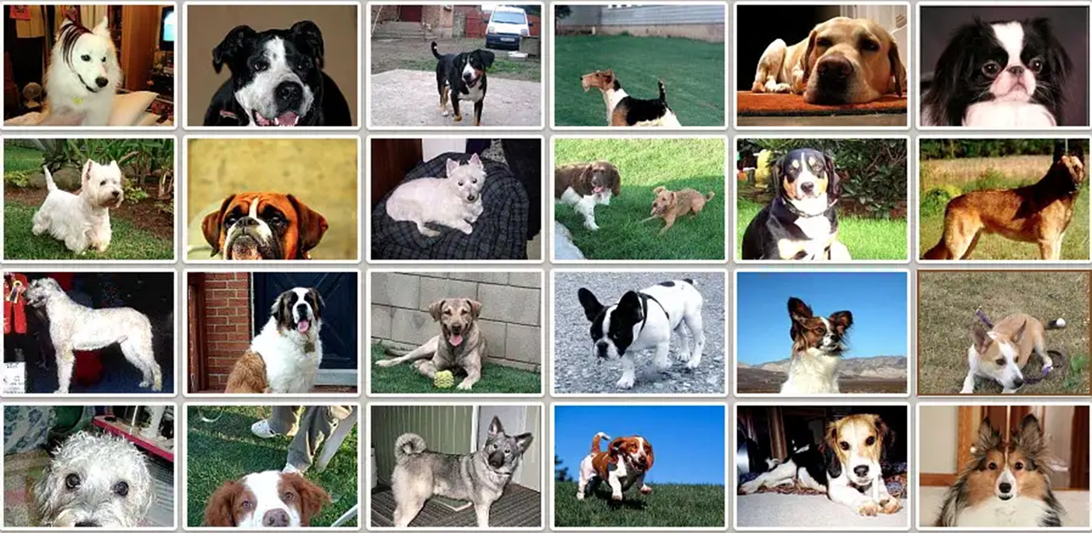

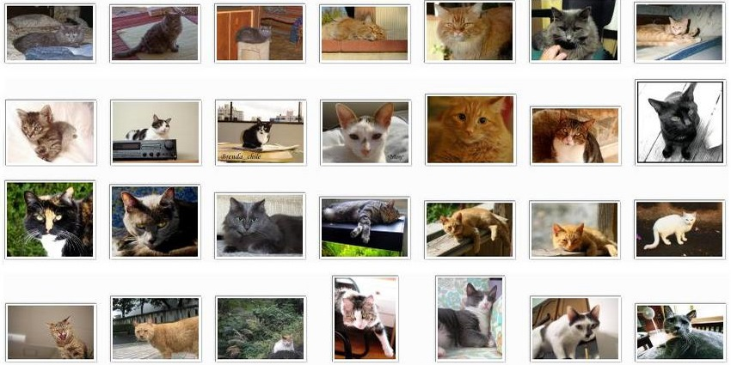

Classification task
«dog»
«cat»

Slide 5
«dog»
«cat»

Slide 6

«medium dog»
«small dog»
«cat»

Slide 7
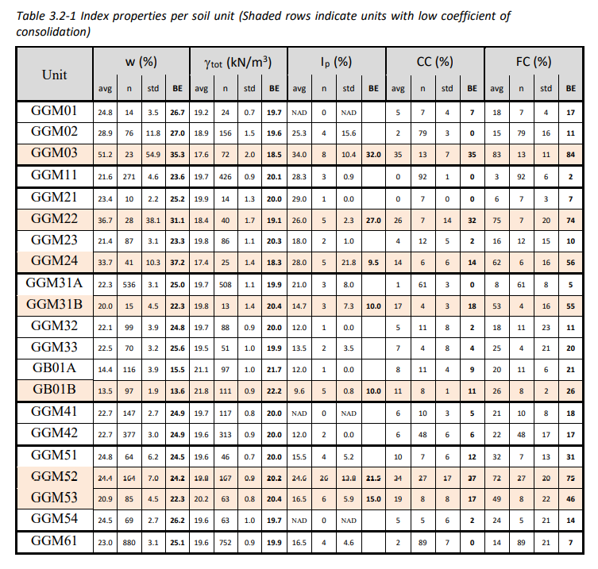
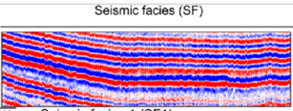

Best guesses within soil units?
$$\hat{ρ}=n^{−1}\sum_{i=1}^{n}{ρ_{i}}$$

Slide 8
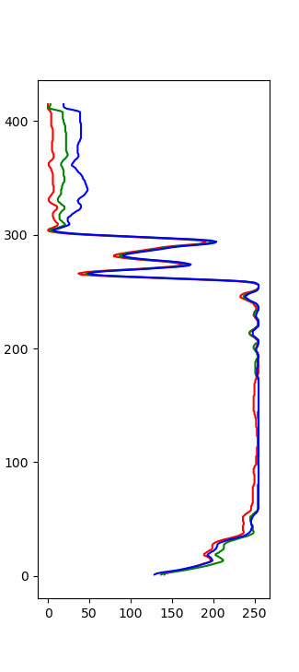
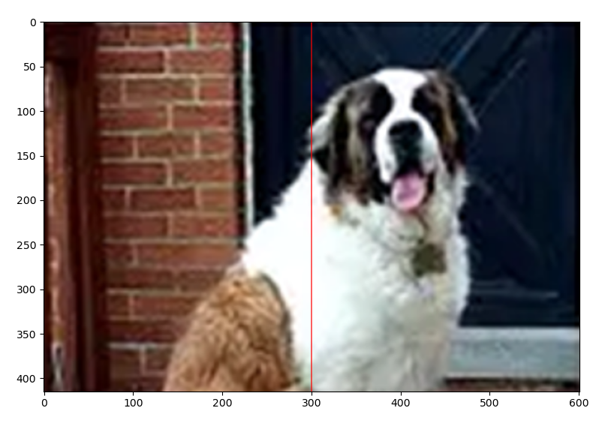
1D vs 2D: Is this a dog?

Slide 9
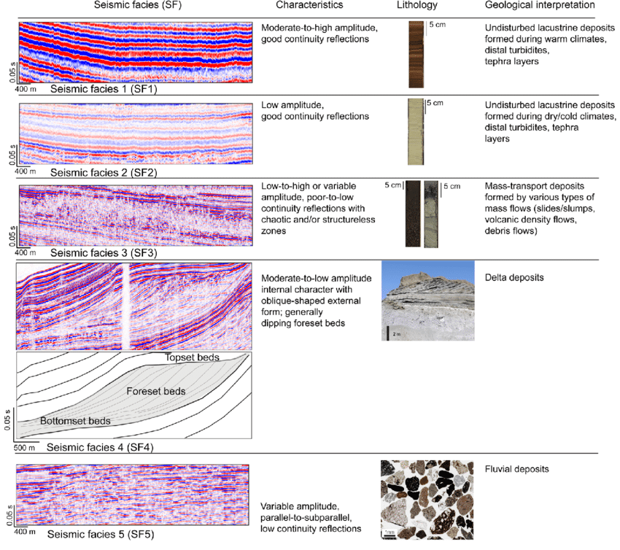





Reasonable basis for prediction ex: Coeff of uniformity
$$C_{u}=lower$$
Humus content high
$$C_{u}=lower$$
Humus content low
$$C_{u}=higher$$
$$⋮$$
$$⋮$$
This human / geological skill uses natural «image recognition». Must make the case that there is a basis for prediction here in a similar way

Slide 10
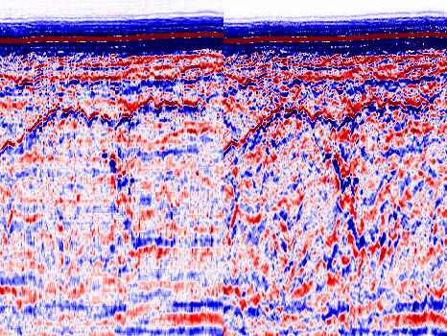
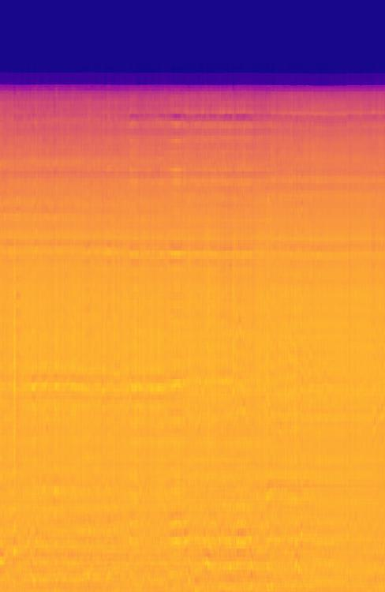
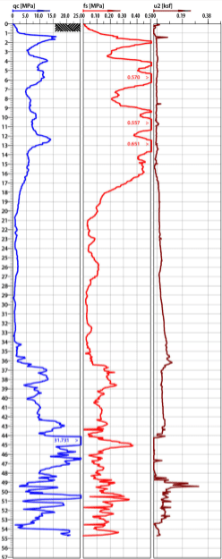
Multi-task learning architecture
CNN
Seismic reconstruction
TCN
Feature Recognition
CNN
Acoustic Impedance Regression
CNN
CPT parameter prediction
The feature recognition saves details deemed relevant during training
These layers interpret the information for prediction

Slide 11
Geological evaluation
The geological experience, which normally is not thought quantifiable, is here what is being quantified in the TCN layer. This is passed to the following layers with a multi channel feature map.
Higher order statistical relationships in the data may be captured in this way.
This is deep learning; we must trust that the learning process captures good relationships
Larger datasets may give better results. Already seen this with training on the dataset.

Slide 12
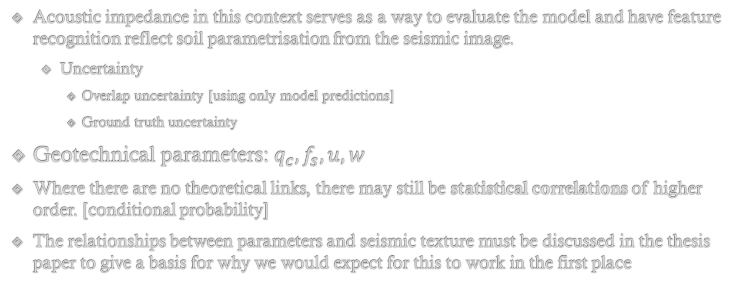
Design parameters
Acoustic impedance in this context serves as a way to evaluate the model and have feature recognition reflect soil parametrisation from the seismic image.
Uncertainty
Overlap uncertainty [using only model predictions]
Ground truth uncertainty
Geotechnical parameters: $q_{c}, f_{s}, u, w$
Where there are no theoretical links, there may still be statistical correlations of higher order. [conditional probability]
The relationships between parameters and seismic texture must be discussed in the thesis paper to give a basis for why we would expect for this to work in the first place

Slide 13
- Discussion -
E. G.
Relationships between seismic attributes and cpt response
Empirical relationships in soil parameters wrt. Seismic Amplitude, velocity or density
Textural information wrt. soil units

Slide 14
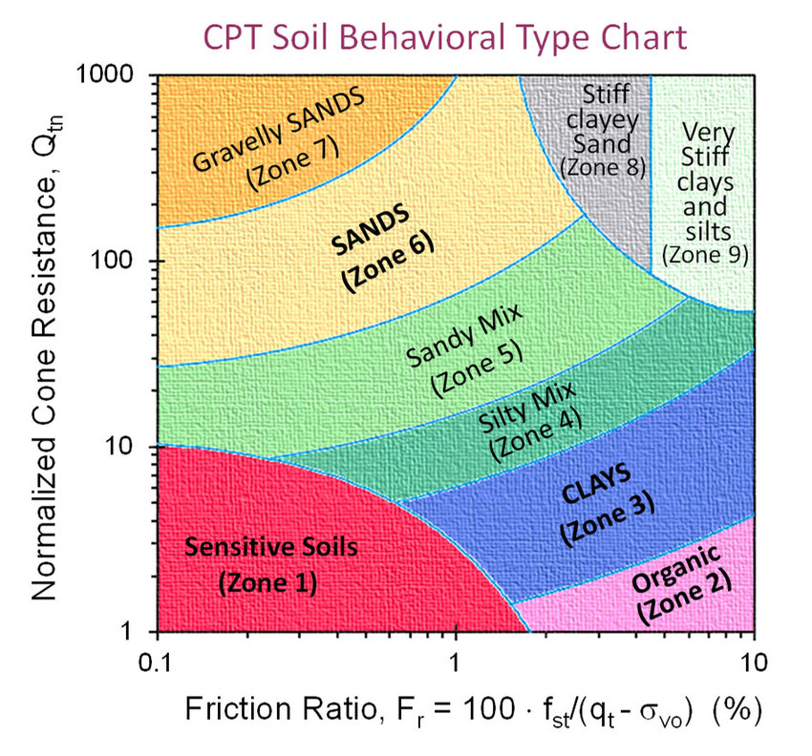
Robertson soil classification

Slide 15
NN Classification task
CNN
Seismic reconstruction
TCN
Feature Recognition
CNN
Acoustic Impedance Regression
z[m] Soil Type Behavior
0.1 sandy mix
0.2 sandy mix
0.3 sensitive soils
0.4 clays
0.5 organic
CNN
CPT parameter prediction
List of categories at different depths

Slide 16
Classification
Neural networks perform well at classification tasks
More sturdy wrt. errors than regression
Not sure how the usefulness is in terms of design
- Discussion -

